Slide 1
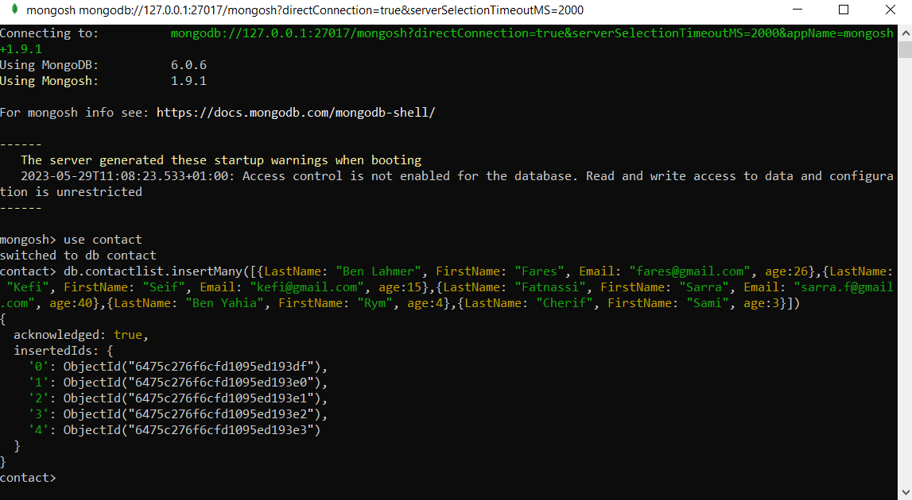
MongoDB (CRUD) Checkpoint

Slide 2
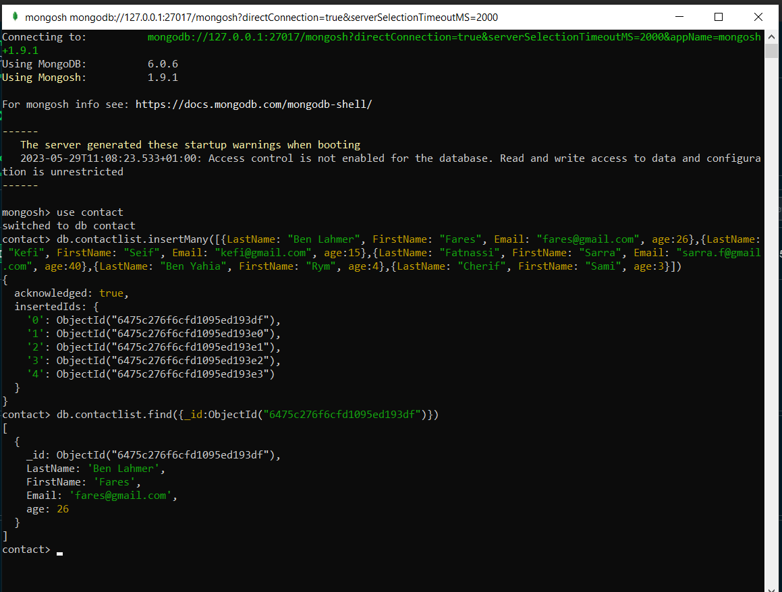
1-Display all the information about only one person using his ID.

Slide 3
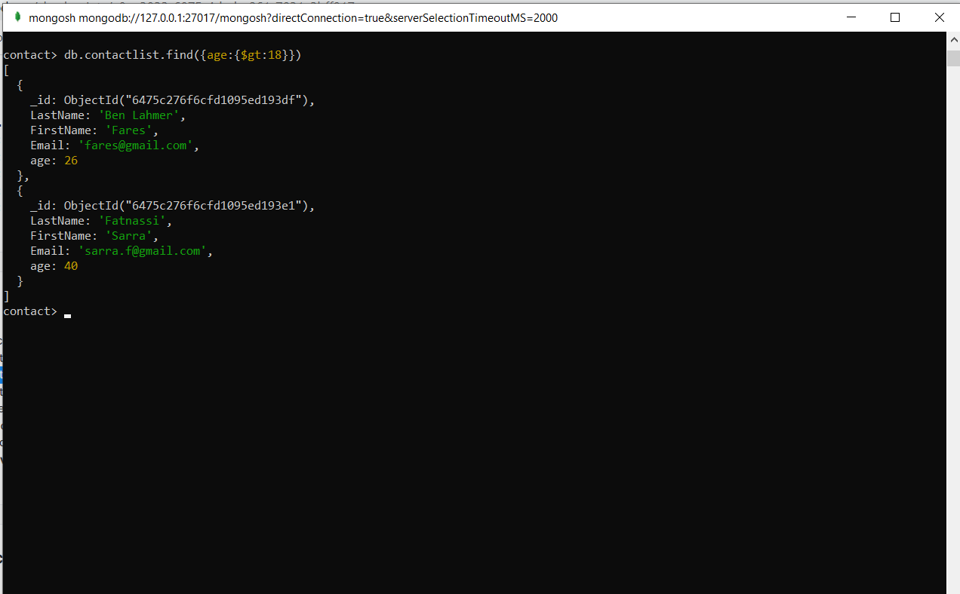
2-Display all the contacts with an age >18.

Slide 4
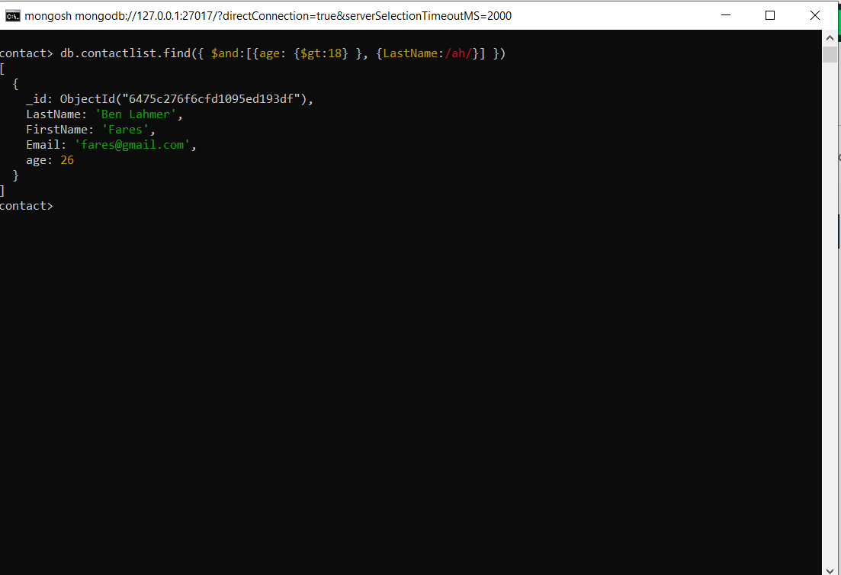
3-Display all the contacts with an age>18 and name containing "ah".

Slide 5
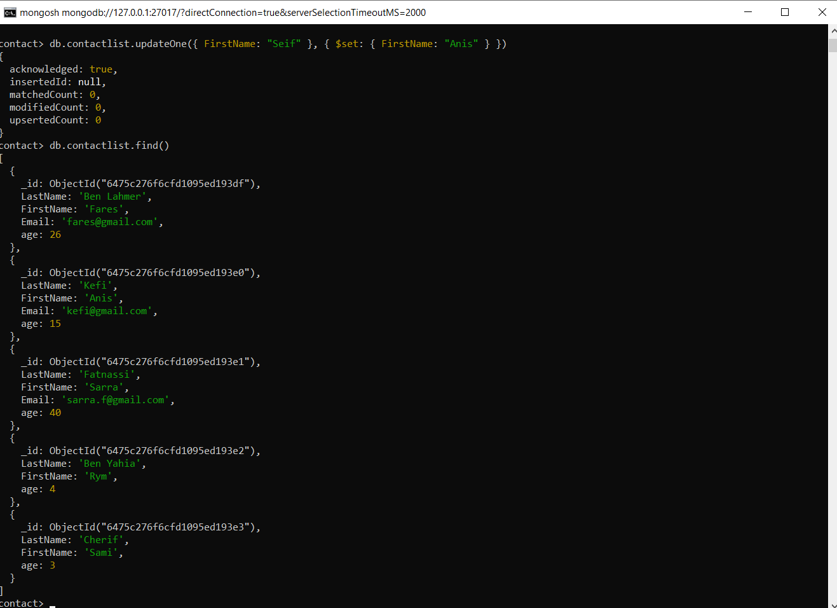
4-Change the contact's first name from"Kefi Seif" to "Kefi Anis".

Slide 6
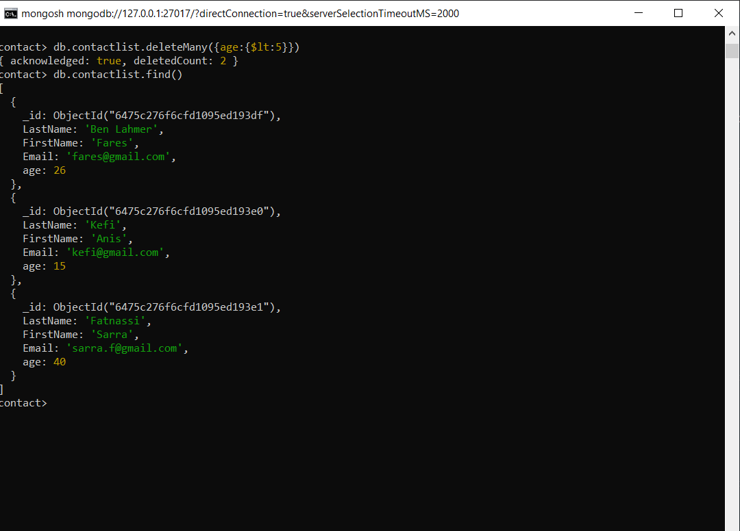
5-Delete the contacts that are aged under <5.

